Slide 1
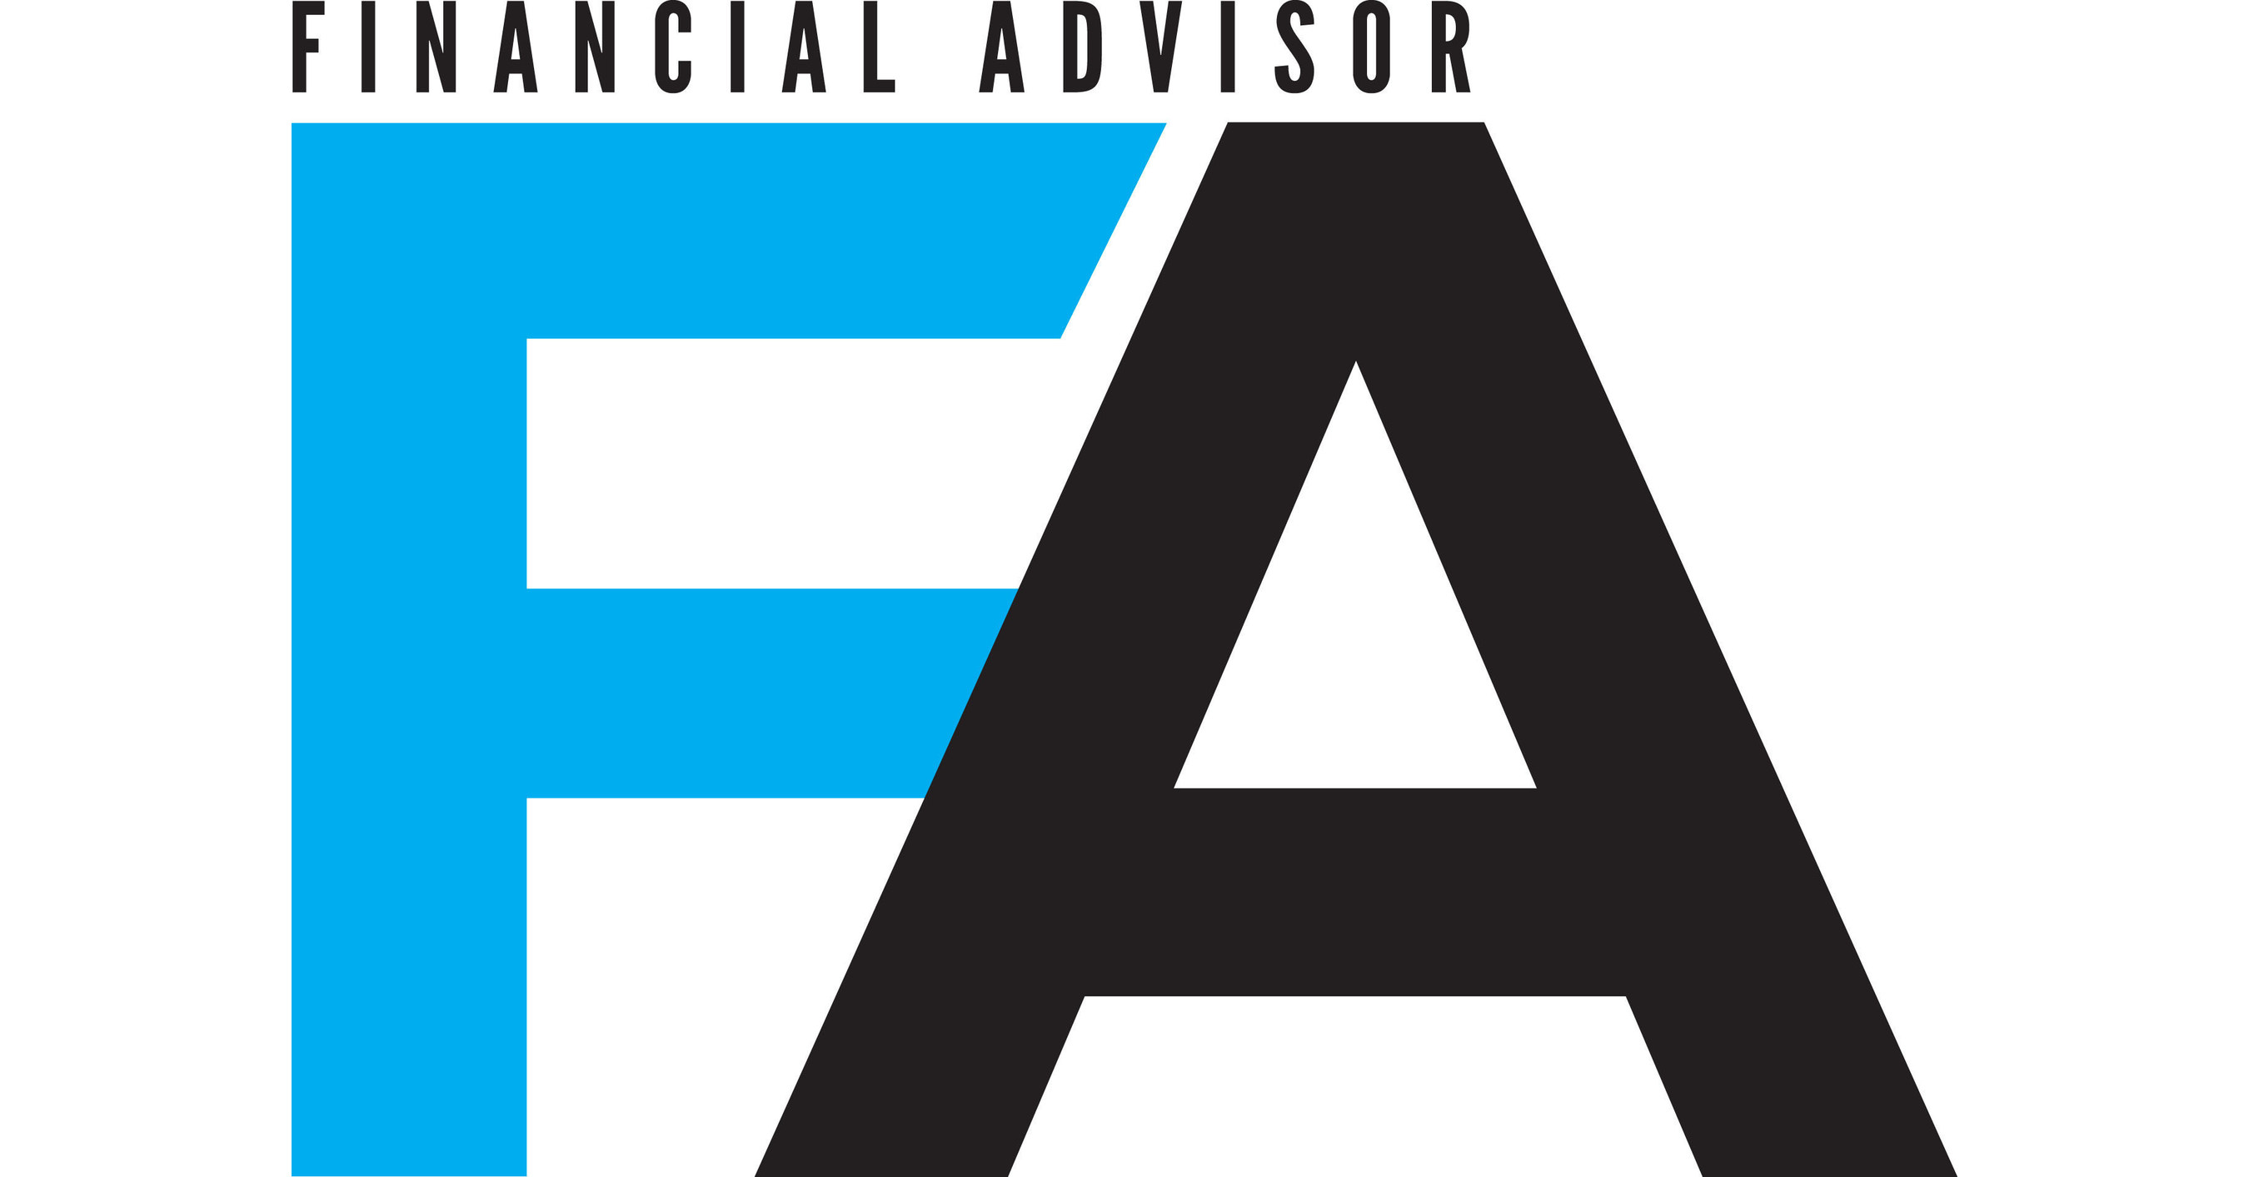
©Copyright 2022 David Macchia. All rights reserved. Constrained Investor® is a registered trademark of David Macchia.

Slide 2
About David
Developer of the revolutionary Constrained Investor strategy for retirement income planning, David Macchia is an author, entrepreneur, public speaker and I.P. inventor whose work is centered on improving Americans’ retirement security. A leading figure in the field of retirement income planning, David is founder of Wealth2k Inc, the nation’s leading provider of advisor-centric income planning solutions. He is the creative force behind the popular, Income for Life Model®, as well as Women & Income®, the first retirement income solution developed expressly for “Boomer” women.
​
David writes frequently about retirement income planning and macroeconomics. His articles have appeared in numerous publications including Advisor Perspectives, Financial Planning, Research Magazine, Retirement Income Journal, Think Advisor, Financial Advisor Magazine, Insurance News Net, and Retirement Investor. He is the author of two books, Lucky Retiree and Constrained Investor: How to Avoid a Devastated Retirement.
​
An accomplished public speaker, David has delivered dozens of keynote addresses for organizations including the Financial Planning Association, Retirement Income Industry Association, Pershing, Bank Insurance and Securities Association, National Association for Fixed Annuities, LIMRA, SRI, and the Insured Retirement Institute.
David earned an MBA, with Honors, from Boston University Questrom School of Business. He holds the RMA and CBBP professional designations.

Slide 3
The Trial of Ken Fisher for Crimes Against Annuities * Go
Don’t Believe in the “Safe Withdrawal Rate” Go
How to Plan Income for a Constrained Investor® Go
The Income Annuity: The Constrained Investor's Life Jacket Go
2025: The “Post Ken Fisher” World of Annuities Go
Why RIAs Are Going to Lose in Retirement Income Go
Why Critics of Bucketing Strategies are wrong Go
The “Impossible” Scenario That Threatens Retirees Go
Man, You’ve Got This! Or Maybe Not GO
How The Fed Is Saving Money Market Funds Go
When Capitalism Died, And How Creditism Replaced It Go
When Advisors Violate Their Fiduciary Duty Go
Resolving the Conflicting Demand Of The Optimistic Pessimist go
There Is No “Safe Withdrawal Rate” Go
The Emperor of All Risks Go
Prepare for the Destruction of $34 trillion in the Coming Months Go
Quotables by Notables on the Subject of Annuities Go
The Price the U.S. Will Pay for Faster Recovery Go
Longevicide Will Erode Clients and Assets Go
How a Nasty Exchange on LinkedIn Led to a New Non-Profit Go
Plan for More Wealth Destruction Go
Will RIAs be Liable for Failed Retirement Income Planning? Go
The Fiction of Safe Withdrawal Rates Go
How to Attract New Clients with Self-Developed Videos Go
Links are active when in PowerPoint “Show” mode
*Advisor Perspectives most read article in 2022
Notes:
Without a plan designed to manage risks, you can be left to luck to dictate your success in retirement. And luck can be good…. Or bad.

Slide 4
Do Advisors Breach fiduciary Duty When They Refuse to Recommend Annuities Go
Retirement Timing Risk and the Constrained Investor Go
Planning for Impossible Outcomes Go
Why Widows Fire 70% of Male Advisors Go
The Soaring Dollar is Crashing Commodities Go
Why Monte Carlo Simulations For Retirement Income Should Be Banned Go
The Bridge Women Will Cross. And Men Will Jump Off Of Go
Notes:
Without a plan designed to manage risks, you can be left to luck to dictate your success in retirement. And luck can be good…. Or bad.

Slide 5
Consumer Audience
The Income Annuity is the Constrained Investor’s Life Jacket GO
How To Think About Annuities GO
The Fed is Preventing Negative Interest Rates, and Keeping Money Market Funds Viable Go
How the U.S. Abandoned Capitalism and What Took Its Place GO
The Ideal Income Strategy for the Optimistic Pessimist Go
Don’t Believe in the “Safe Withdrawal Rate” Go
For Retirees It’s About Your Income, Not Your Wealth Go
What ROI means or should-mean to retirees go
Plan for key risks in retirement if you’re a constrained investor Go
Notes:
Without a plan designed to manage risks, you can be left to luck to dictate your success in retirement. And luck can be good…. Or bad.

Slide 6
Investment Advisor Audience
RIAs Must Pivot or Face Certain Decline Go

Slide 7
The Tragic Politicization of Annuities Go

Slide 8
Insurance Advisor Audience
Why We Must Join Together To Launch A Bold New Era Of Annuity Sales Growth Go
Serving the Constrained Investor – with David Macchia G0
Links are active when in PowerPoint “Show” mode

